Slide 1
WEATHER PREDICTION CASE STUDY : Rain in Australia
Mungunsi W. N.

Slide 2
AIM AND REQUIREMENTS
AIM
The aim of our work is to realize a model that predict if there will be rain fall tomorrow from data we have today. So we will build a supervised learning data learning model with our historic data.
REQUIREMENTS
For this project to come to completion we will use the following big data tools:
*QuickTable
*Vscode
*Python 3.7

Slide 3
DATASET
Our dataset is the weatherAUS.csv dataset gotten from http://www.bom.gov.au/climate/data.This dataset contains about 10 years of daily weather observations from numerous Australian weather stations.
RainTomorrow is the target variable to predict. It means -- did it rain the next day, Yes or No? This column is Yes if the rain for that day was 1mm or more.
The dataset contains about 145460rows and 23columns

Slide 4
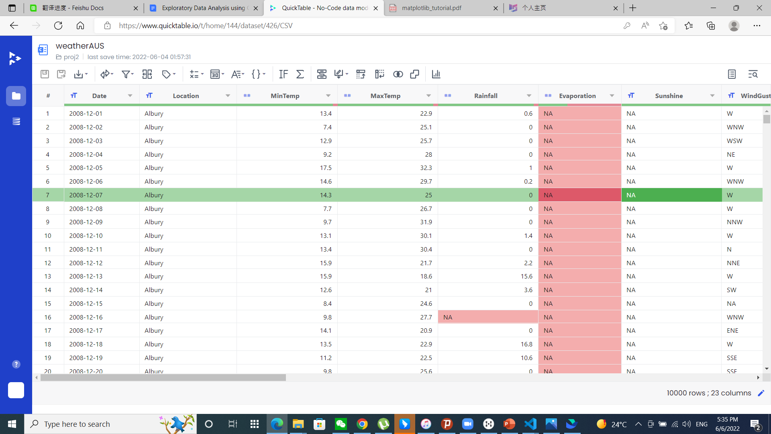
EXPLORATORY DATA ANALYSIS
For exploratory data analysis we are going to use QuickTable. After uploading our dataset to QuickTable, it looks like this:

Slide 5
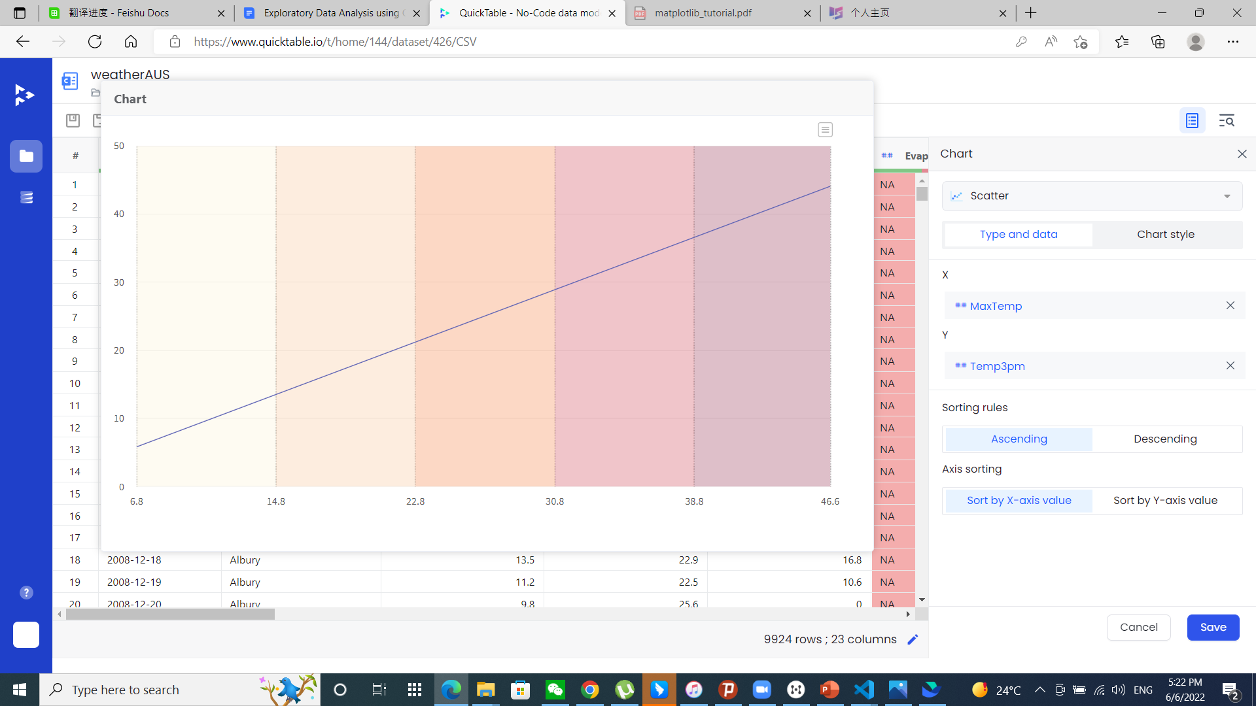
Below is a line plot of MaxTemp and Temp3pm

Slide 6
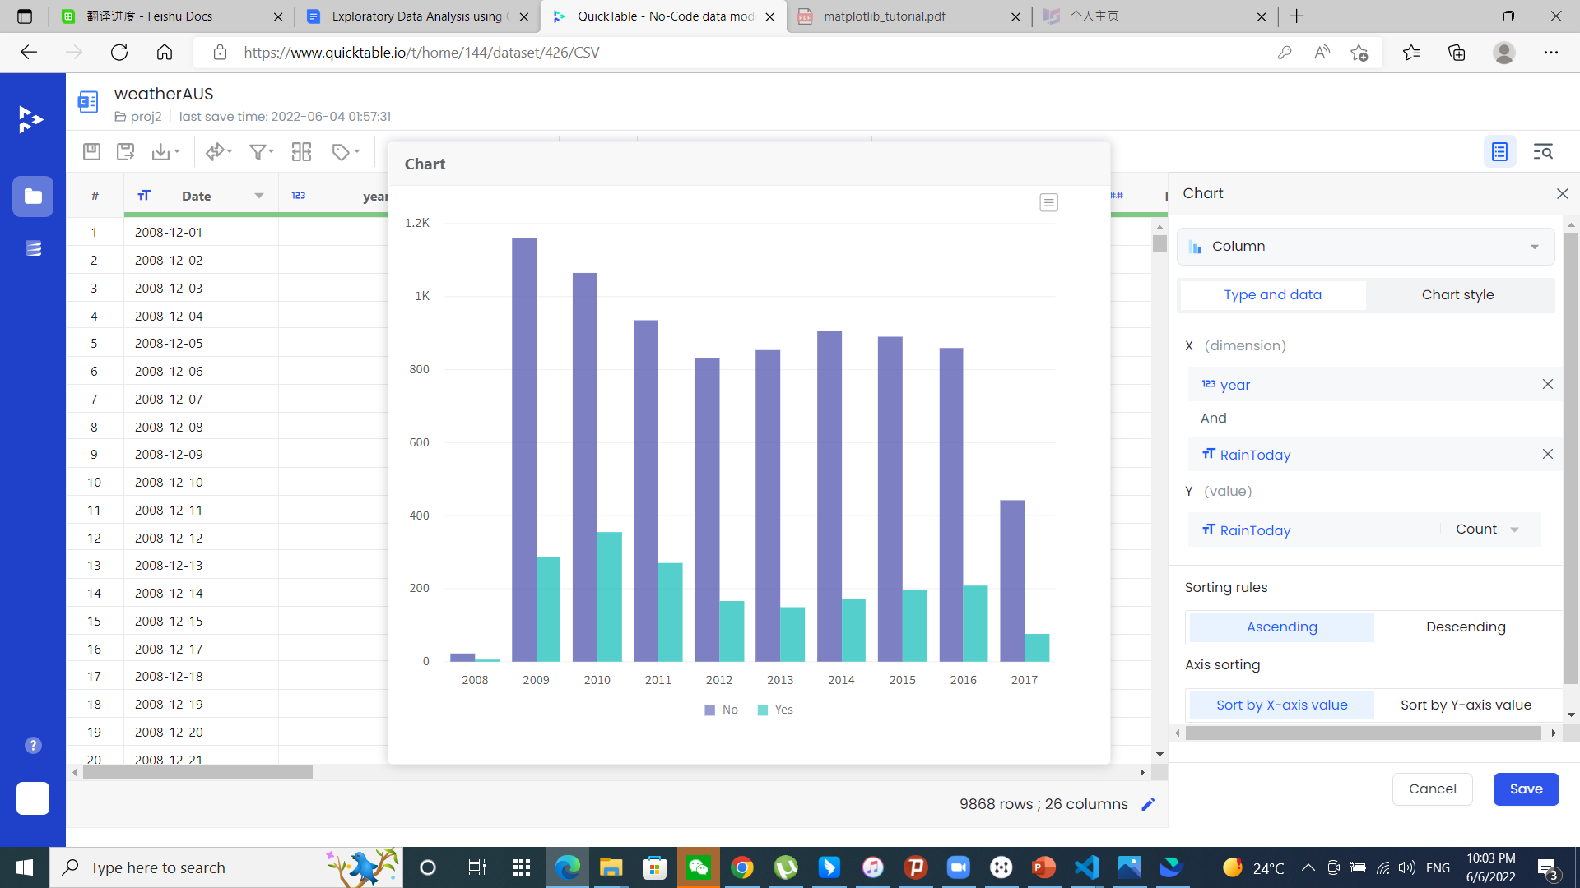
Below is a histogram of year and RainToday count

Slide 7
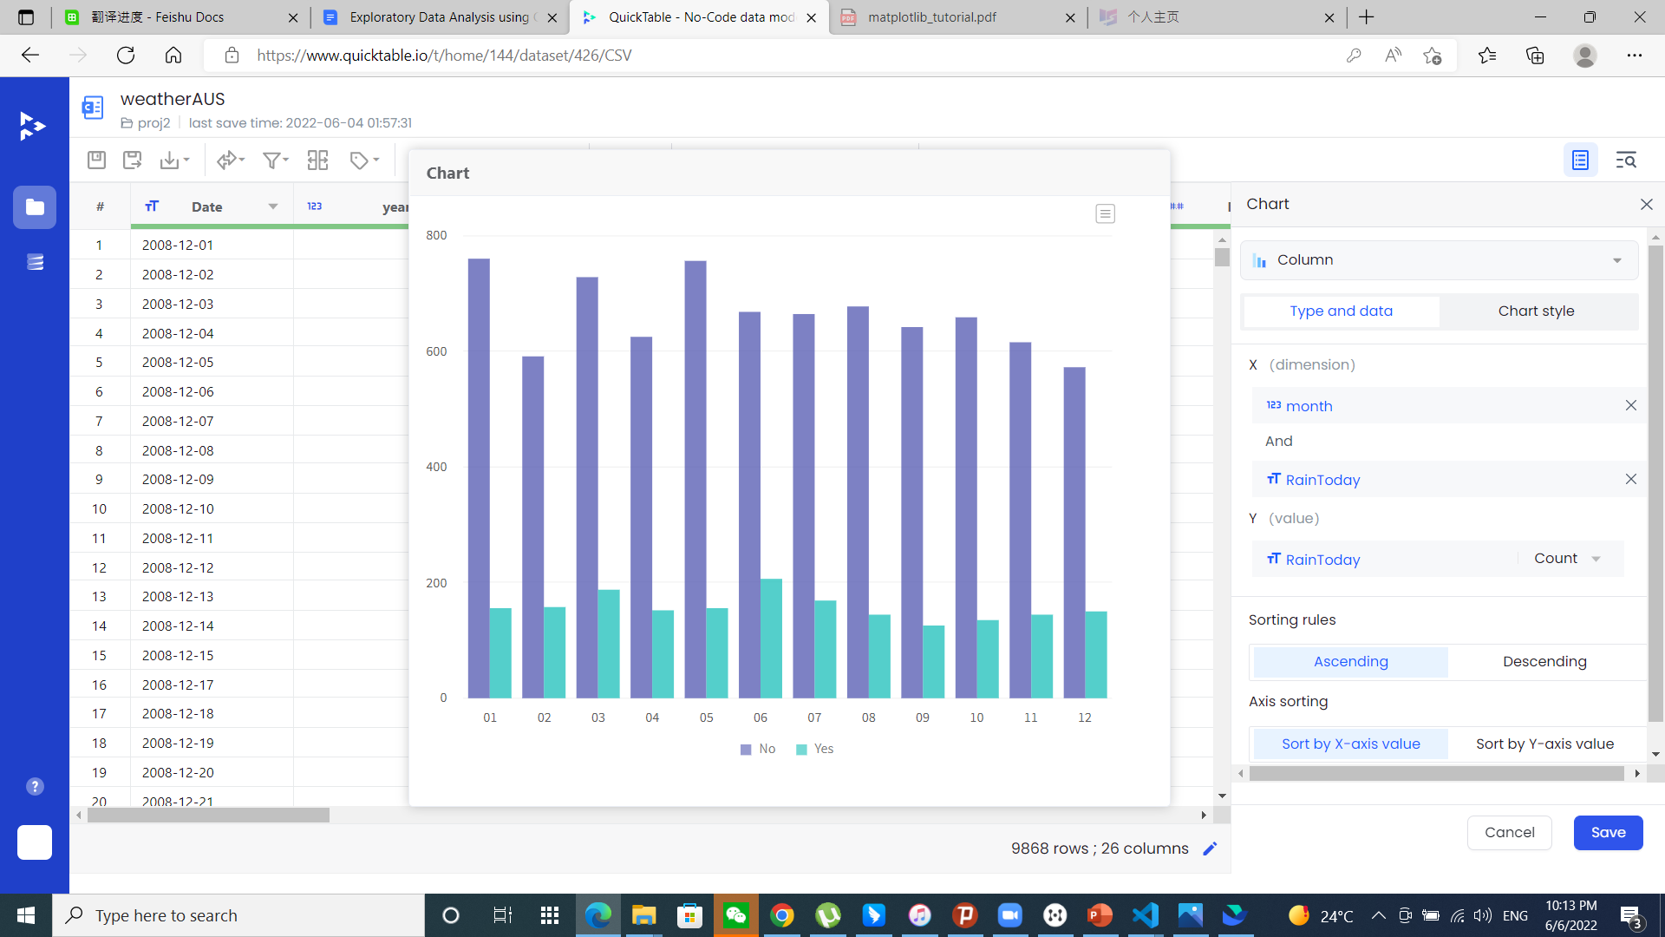
Below is a histogram of month and RainToday count

Slide 8
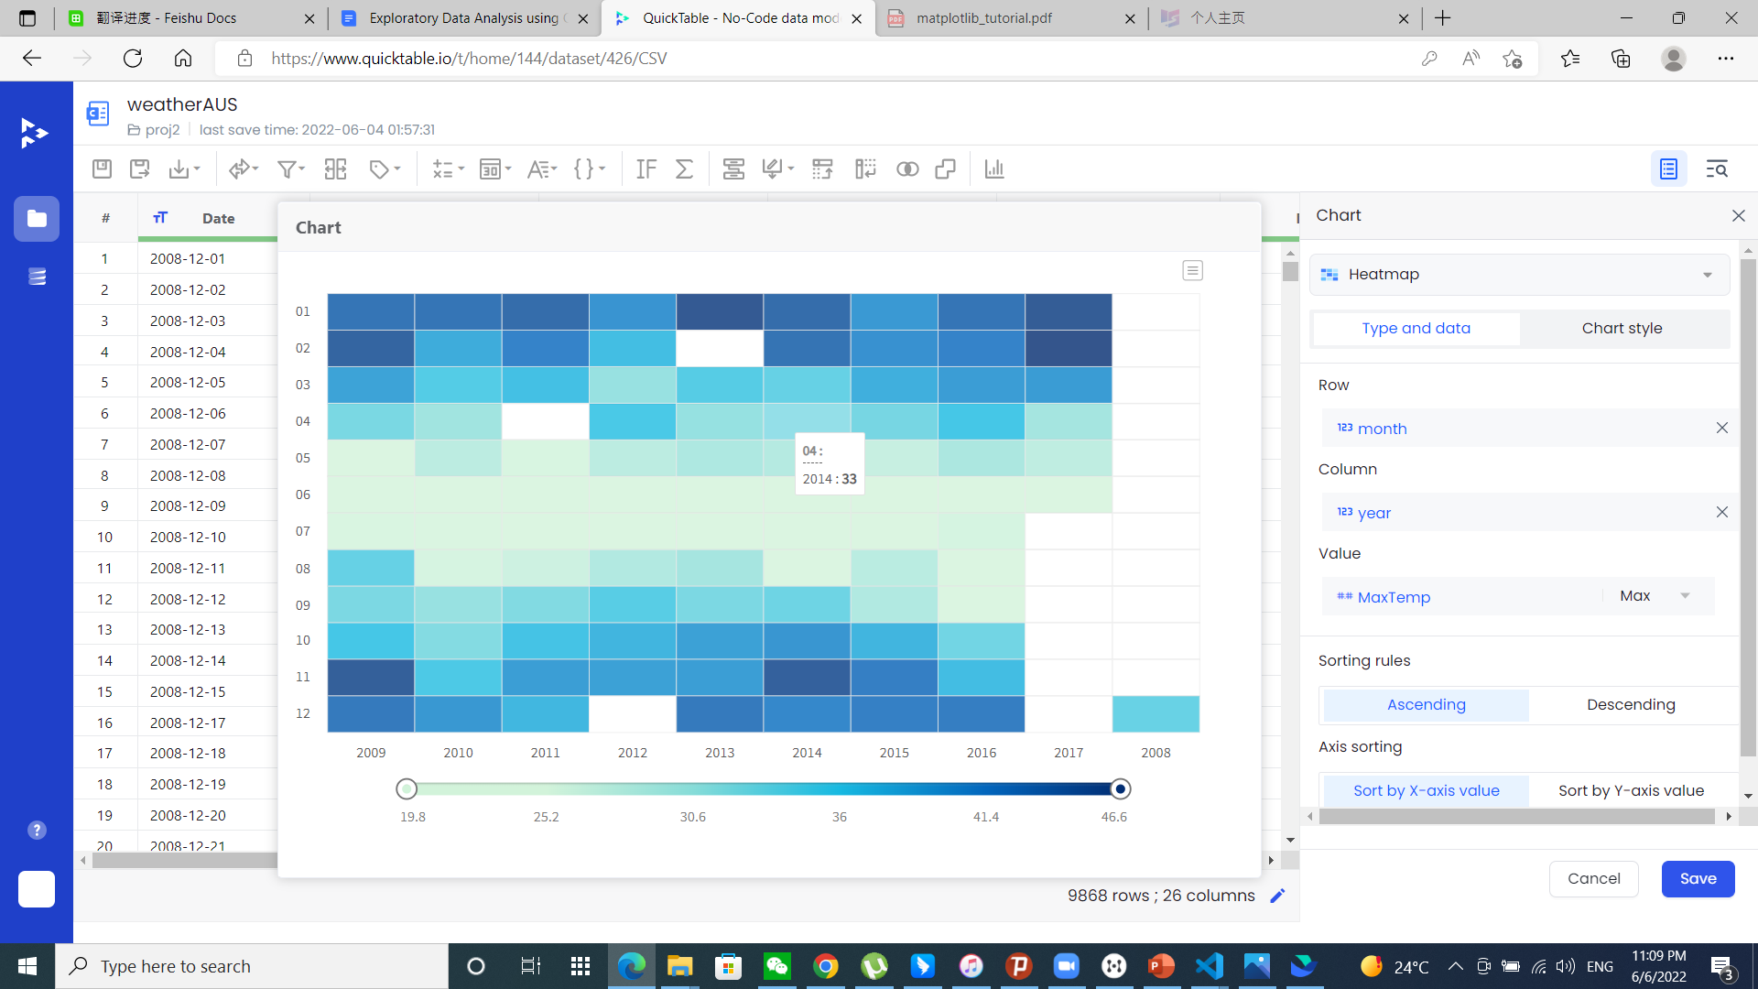
Below is a heatmap of month and MaxTemp

Slide 9
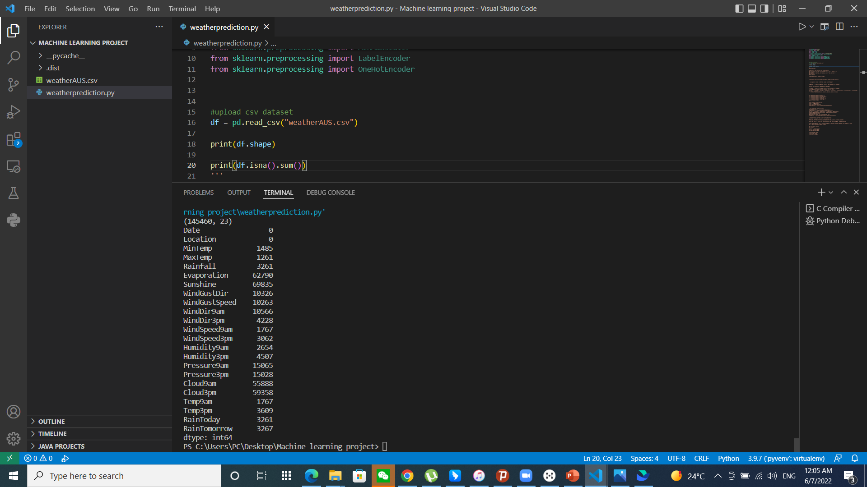
DATA CLEANING

Slide 10
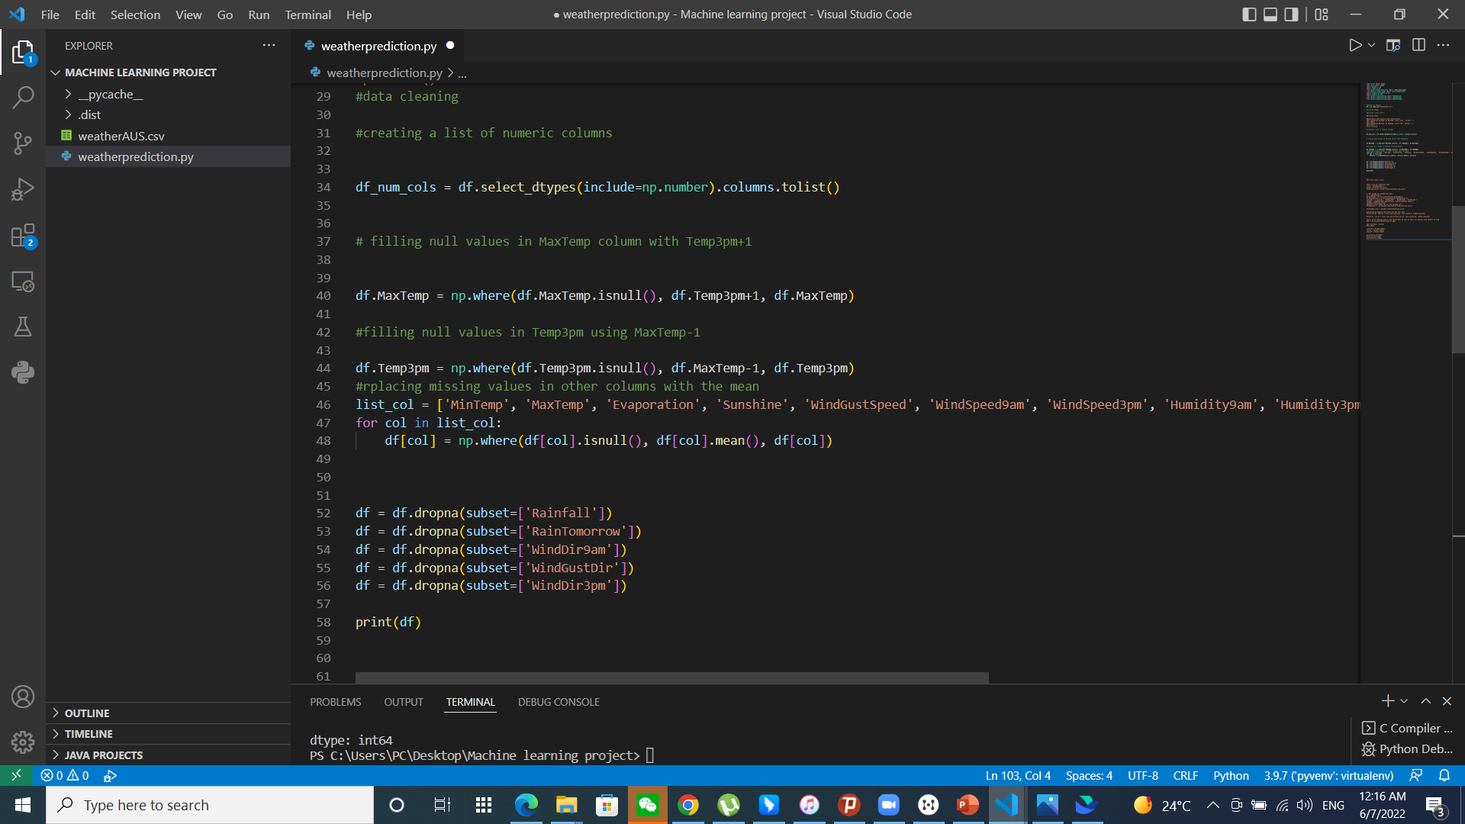
DATA CLEANING

Slide 11
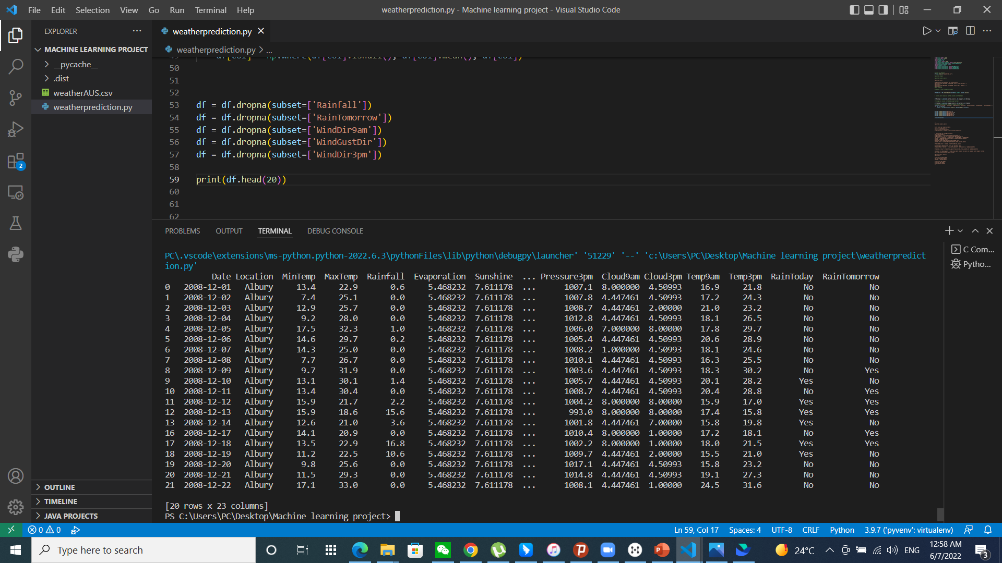
DATA CLEANING

Slide 12
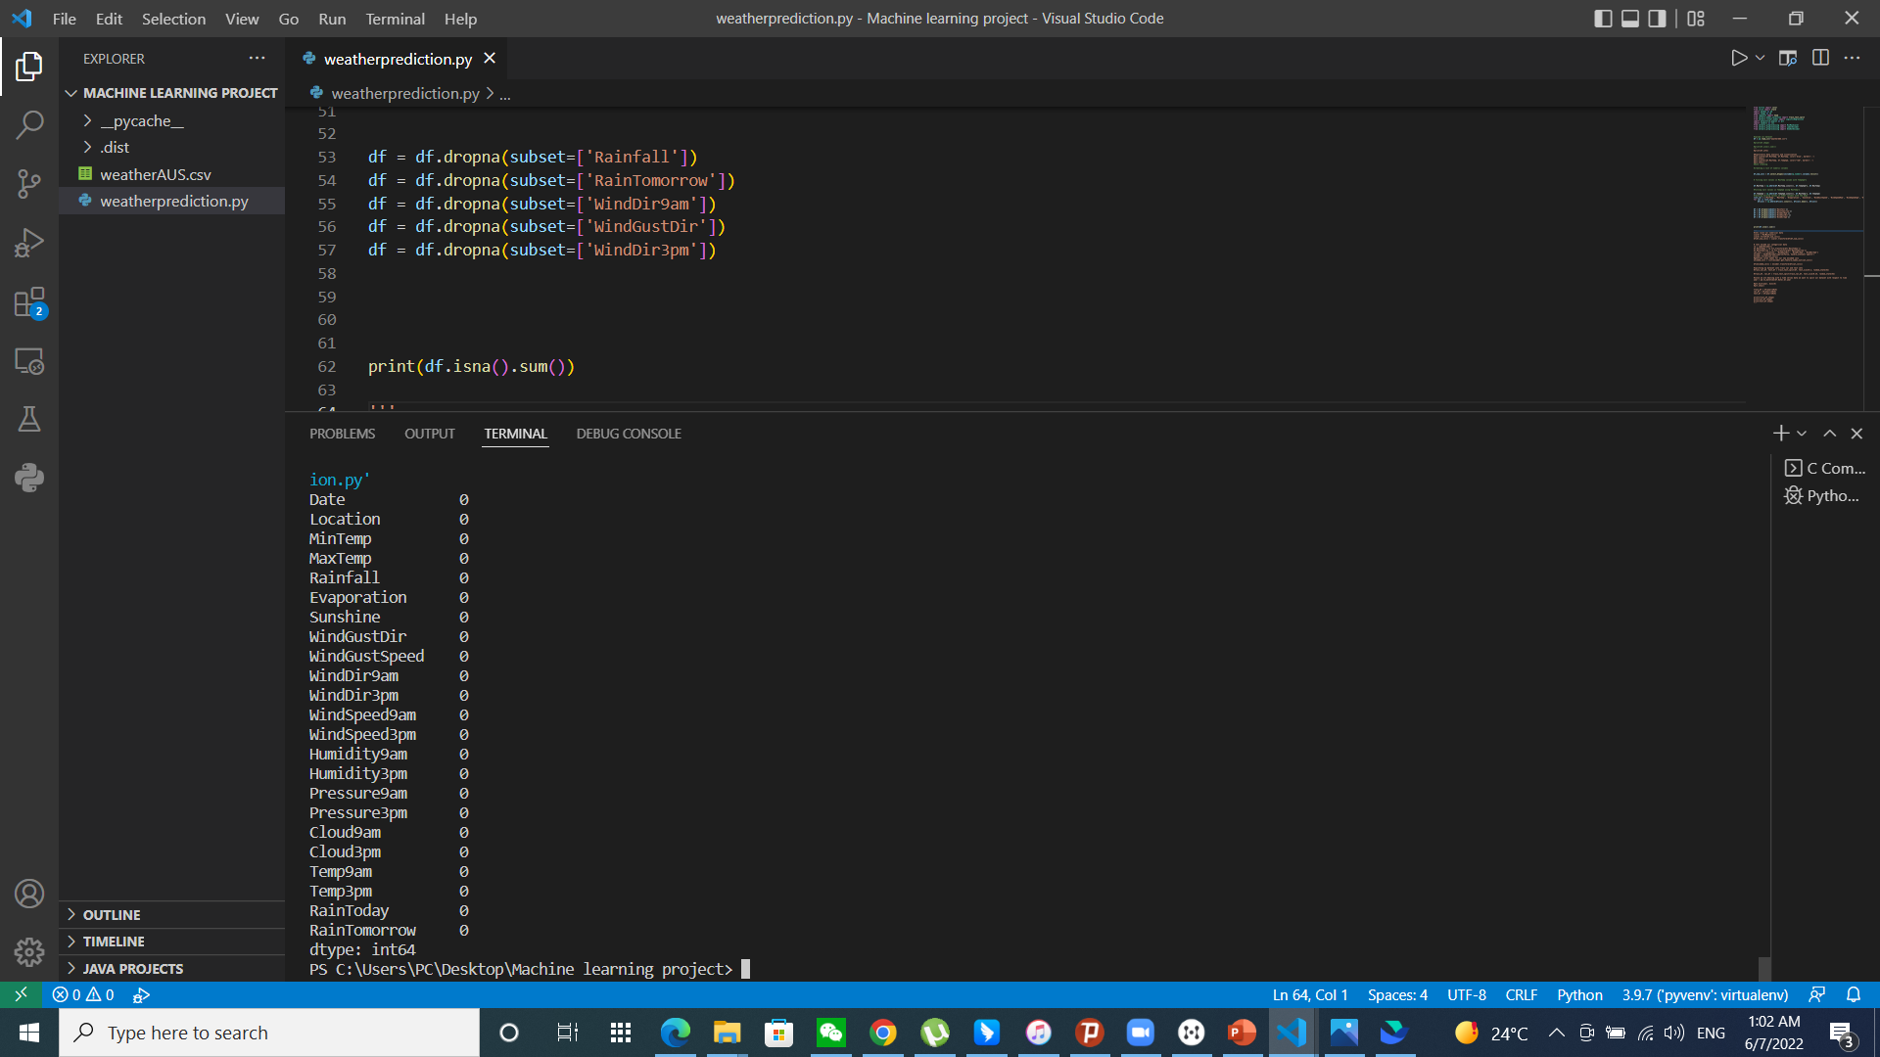
DATA CLEANING

Slide 13
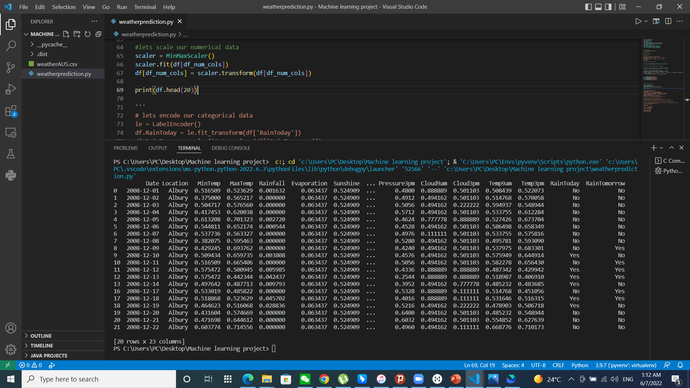
SCALE NUMERICAL DATA COLUMNS

Slide 14
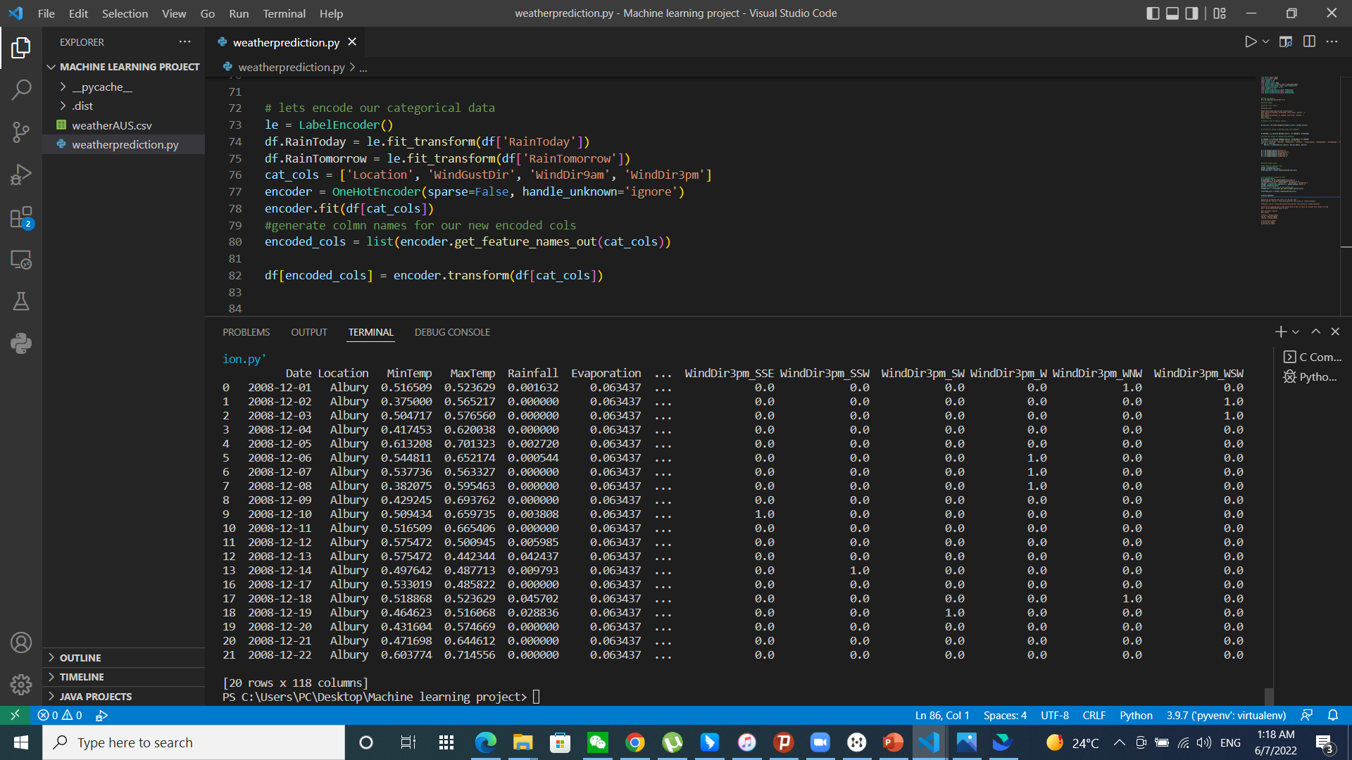
Encode categorical data COLUMNS

Slide 15
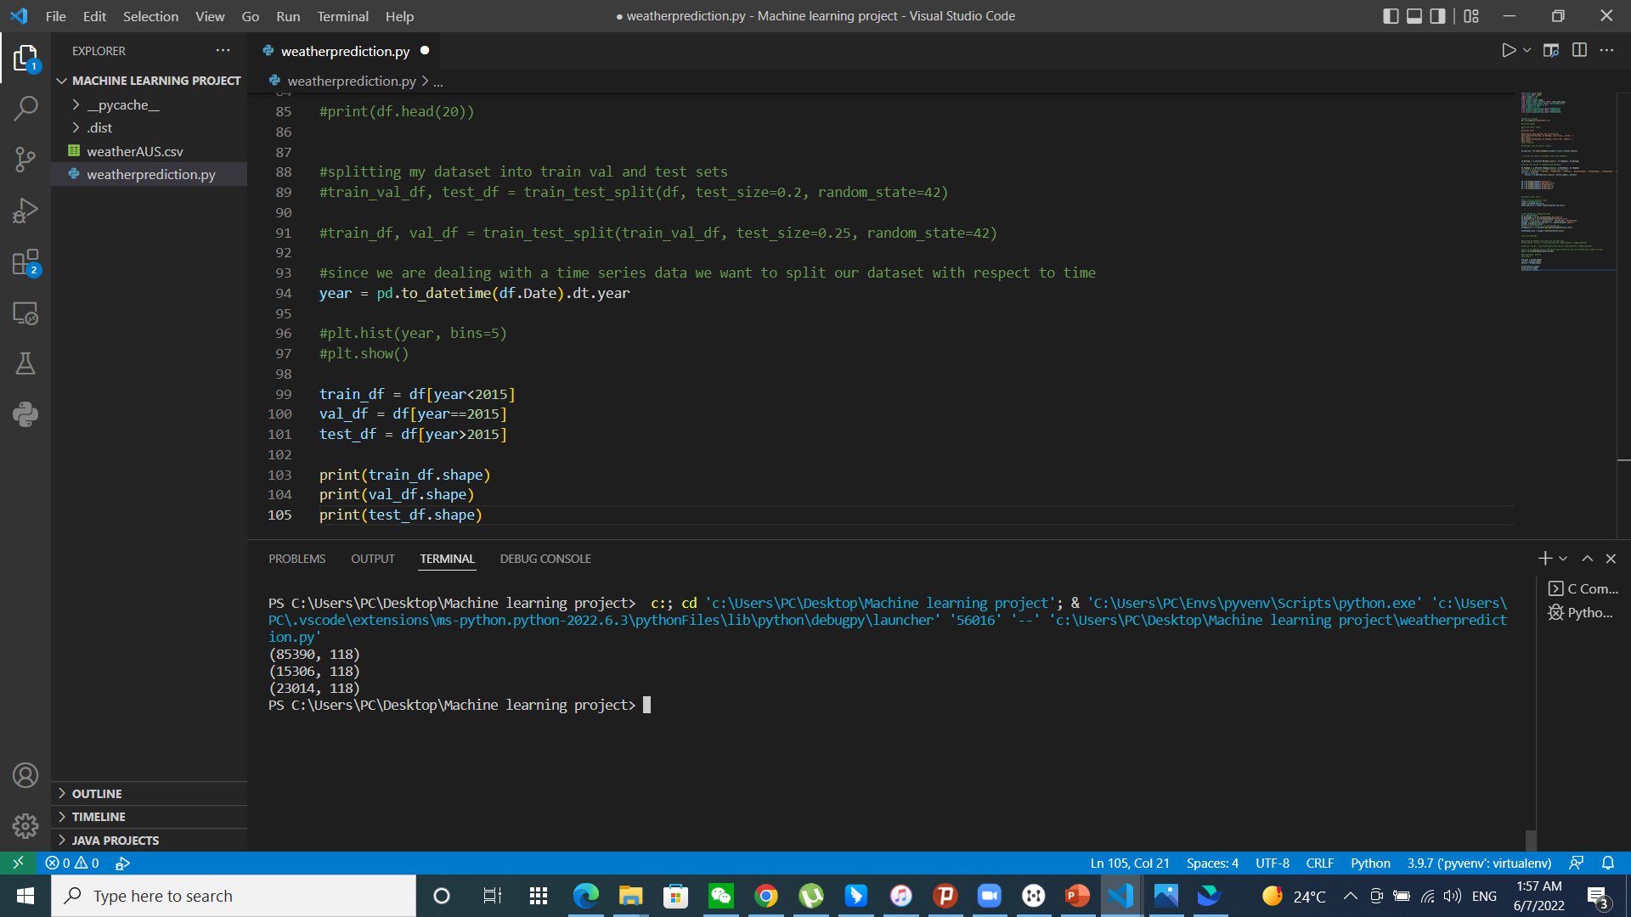
SPLIT THE DATASET INTO TRAIN, VALIDATION AND TEST PARTITIONS

Slide 16
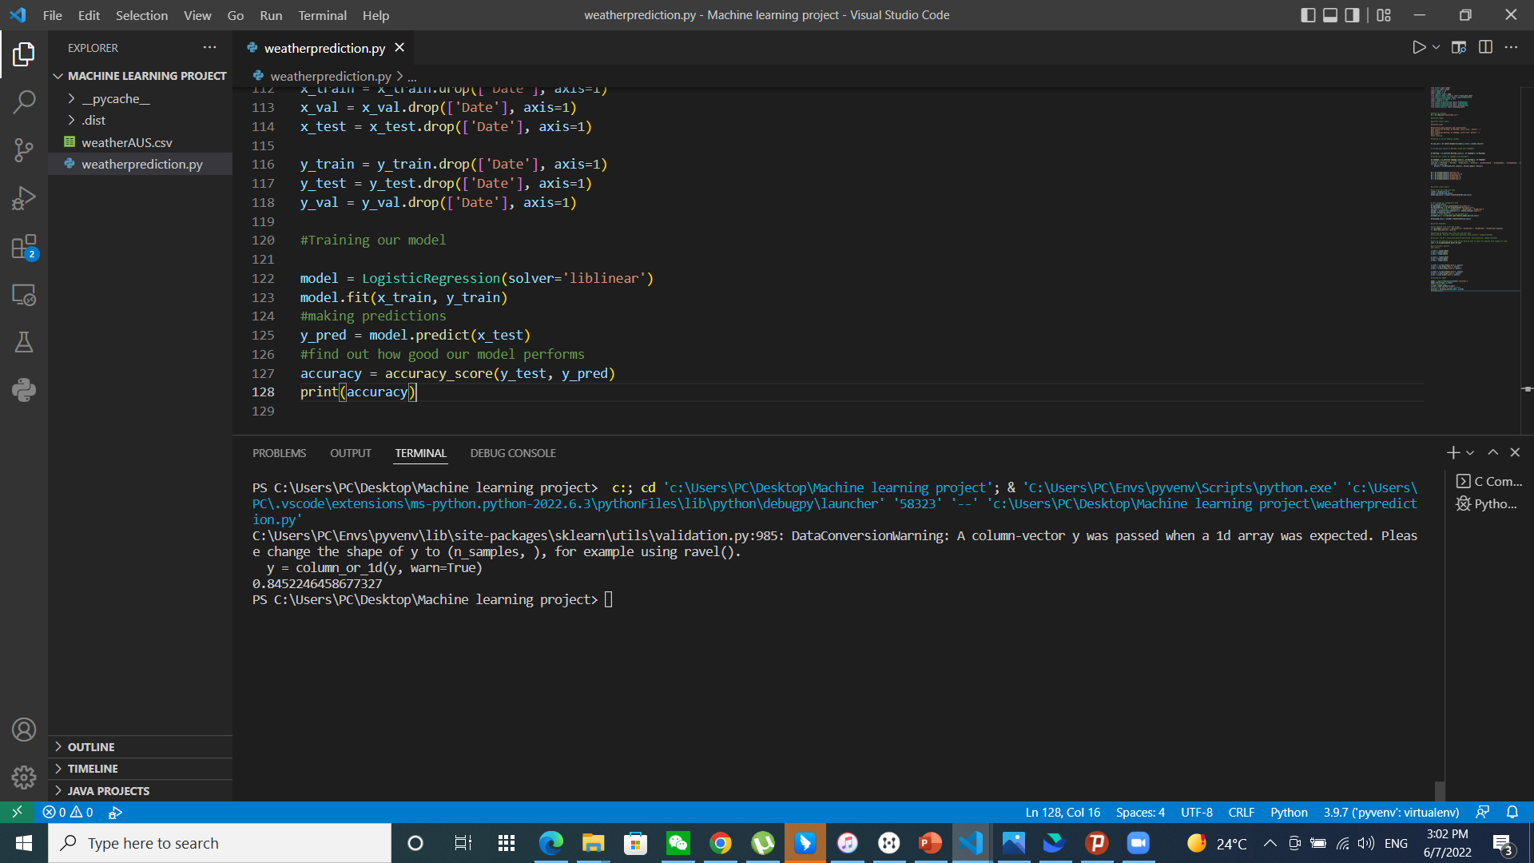
TRAINING AND TESTING THE MODEL

